Slide 1



E-learning Website
:: Team Members ::
1. YOGITA BHARDWAJ 19BCE10187
2. MAULI BHATNAGAR 19BCE10284
3. ASHWINI DARADE 19BCE10311
4. JHANVI TRIPATHI 19BCE10344
Guide – Dr. Sountharrajan S sir

Slide 2

INTRODUCTION
E-learning website is a growing field. Traditionally it has referred to full-scale distance education. Normally it has been practiced in higher education and corporate and occupational training contexts as a part of lifelong learning. However, with the emergence of new open and mobile platforms and web apps, a range of possibilities has opened to facilitate teaching and learning processes in fully on-site or blended environment

Slide 3

As a result, e-learning has been implemented in all educational systems, transcending the traditional idea of distance education.
The information provided by this presentation shows where the resources and efforts for e-learning research are being focused. It also indicates the type of methodology followed, existing work with limitations, real time usage, hardware and software requirements, novelty of the project, module description, module work flow explanation including demo video and snapshot of the project, testing and conclusion

Slide 4

EXISTING WORK WITH LIMITATIONS
Digital revolution affects education too, changing the whole learning process in so many ways. The word “e-learning” doesn’t sound unfamiliar to many of us these days. Moreover, most of us associate it with not only technological progress but also with big opportunities.
There are so many sites present in the world which provide e-learning services and taking one step further for education
But these sites are more complex with more limitations so we have collected all the data and the tools which are necessary for a good e-learning website with minimum limitations

Slide 5

LIMITATIONS
E-learning depends on technology a lot. For example, older students might find it hard to master all the newest tech gigs. This problem will be solved by our website by providing some proper tutorials.
Some find it hard to motivate and organize themselves. Some students cannot do the self organization without a clear deadline on writing a team paper and the need to report their progress to the teacher.
Some students might feel isolated
The feedback might not be enough. The feedback is one of the biggest drivers of student’s progress.
To my opinion, e learning can become a great addition to the traditional learning process.

Slide 6

PROPOSED WORK & METHODOLOGY
Our e-learning platform will try to overcome with every present limitation to provide a better service to students.
Any student who is new to this platform or any older student who is not comfortable with these online services could easily use this.
Our platform will provide services like different courses, videos, tutorial for easy learning.
All you have to do is just enroll in the course and start learning with a pc or smartphone.

Slide 7

We have presented comprehensive study of different e-learning. This study would help researchers involved in development of e-learning. In the world of cloud computing, there is a need to develop a cloud based learning management system (CLMS) which can incorporate all the features discussed in previous section and new features like automatic assignment evaluation with the integration of plagiarism detector and keyword matching, web based virtual workshop management and single sign on.

Slide 8

NOVELTY OF THE PROJECT
This platform is to provide educational services to students of school and college.
This idea was proposed on the basis of providing and ensuring good quality of courses and content for students.
Our team will use html, css and java for this website.
We will use the best video links from youtube to provide best content for the students.

Slide 9
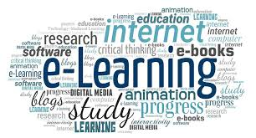
REAL-TIME USAGE
You are able to link the various resources in several varying formats.
It is a very efficient way of delivering courses online.
Due to its convenience and flexibility, the resources are available from anywhere and at any time.
Everyone, who are part time students or are working full time, can take advantage of web-based learning.
As you have access to the net 24x7, you can train yourself anytime and from anywhere also.

Slide 10

Web-based learning promotes active and independent learning.
It is a very convenient and flexible option; above all, you don't have to depend on anyone for anything.
Not only you can train yourself on a day to day basis, but also on weekends or whenever you have the free time to. There is no hard and fast rule.
Through discussion boards and chats, you are able to interact with everyone online and also clear your doubts if any.

Slide 11




HARDWARE & SOFTWARE REQUIREMENTS
SUBLIME TEXT EDITOR – for coding
NOTEPAD – for coding
csstricks.com – for css
For graphic programs and resources
-canva

Slide 12



HTML - For the structure of the web content
CSS - For presentation and styling of the web content
JAVASCRIPT - For creating web pages

Slide 13
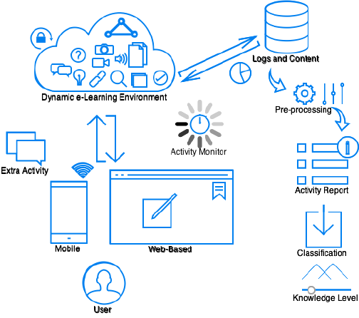
OVERALL SYSTEM ARCHITECTURAL DIAGRAM

Slide 14
LITERATURE REVIEW
Despite the enormous growth of e-learning in education and its perceived benefits, the efficiency of such tools will not be fully utilized if the users inclined to not accept and use the system. Therefore, the successful implementation of e-learning tools depends on whether or not the students are willing to adopt and accept the technology. However, recent studies have shown that e-learning implementation is not simply a technological solution, but also a process of many different factors such as social factors , individual factors , organizational such as facilitating conditions in addition to behavioral and cultural factors .Such major factors play an important role in how an information technology is developed and used .To ensure all these factors we have developed a website which is user friendly and can be easily access from any place

Slide 15
MODULE DESCRIPTION
The MODULES OF THIS WEBSITE CONTAINS-
-----A LOGIN BOX
-----A SIGNUP BOX
List of subjects and inside them we put the study material and video links that will help the help to completely understand the particular topic or course. The Layout of the website is simple that enable the user to find their matter easily without facing any problem. This website is useful and beneficial for the engineering students and for all those students who wants to learn specific course and we have put the content that can be easily understand .EACH MODULE OF THIS WEBSITE ARE MADE IN SUCH A WAY THAT IT Establish and maintain an environment for learning , available anywhere ,A platform that is available 24/7 and hasAccess to online resources

Slide 16
MODULE WORK FLOW EXPLANATION
When the person open the website for the first time he/she will have to go to the signup box to enter his/her details and set the password for their account then they have to login their account from the login box . Then they have to select the course that they want to study by clicking on its icon. When they click on the icon a dialog box will appear that contain PPT and Video links and by clicking on them ppt or video will start.

Slide 17
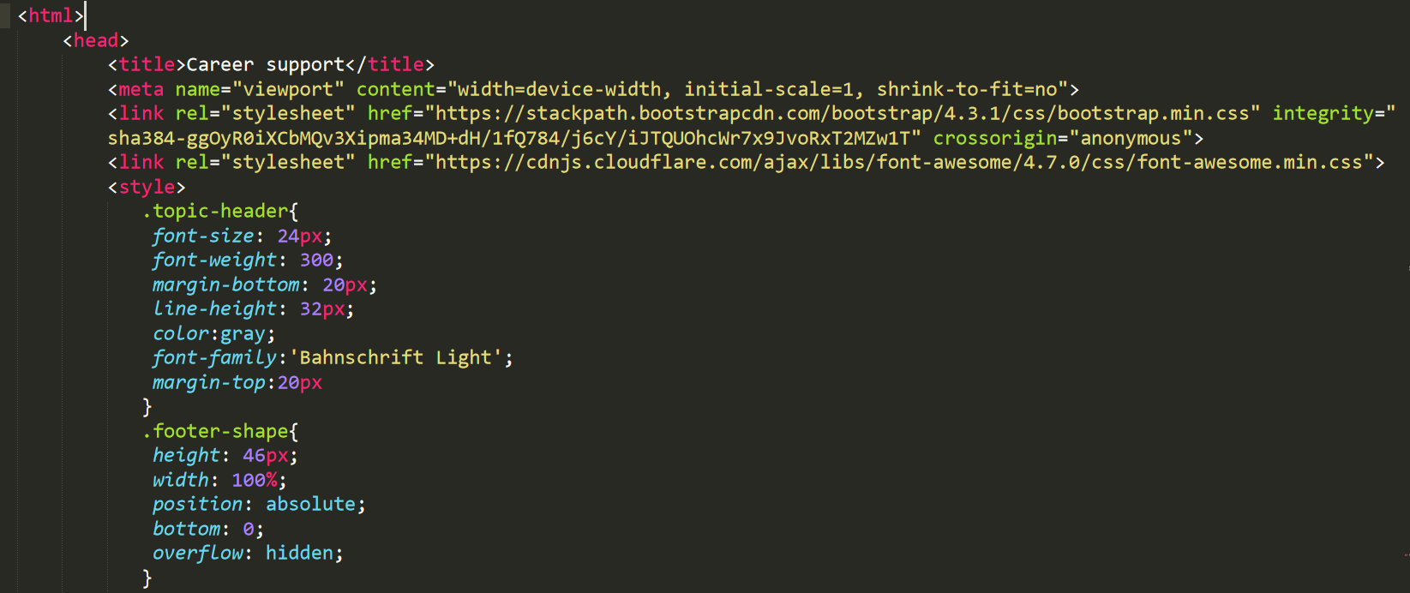
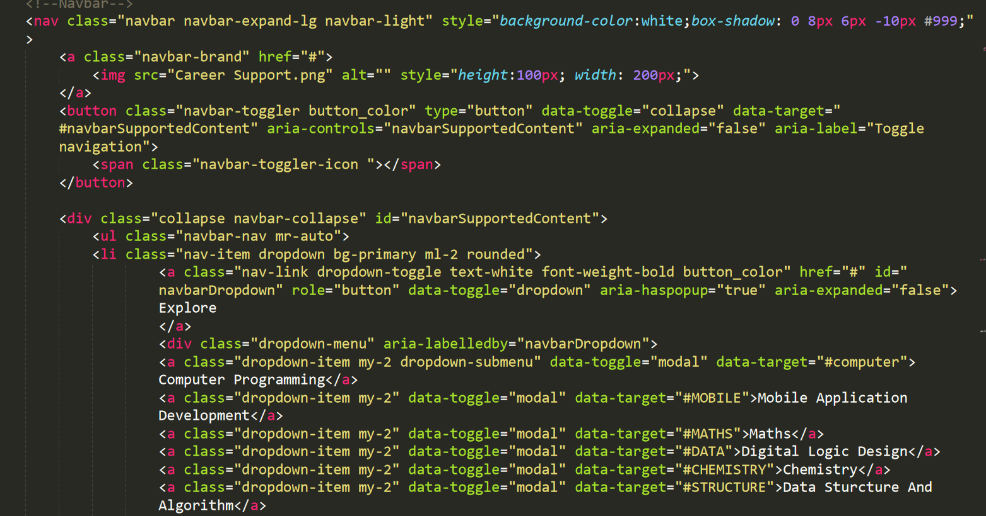
IMPLEMENTATION & CODING
An instant of coding in HTML

Slide 18
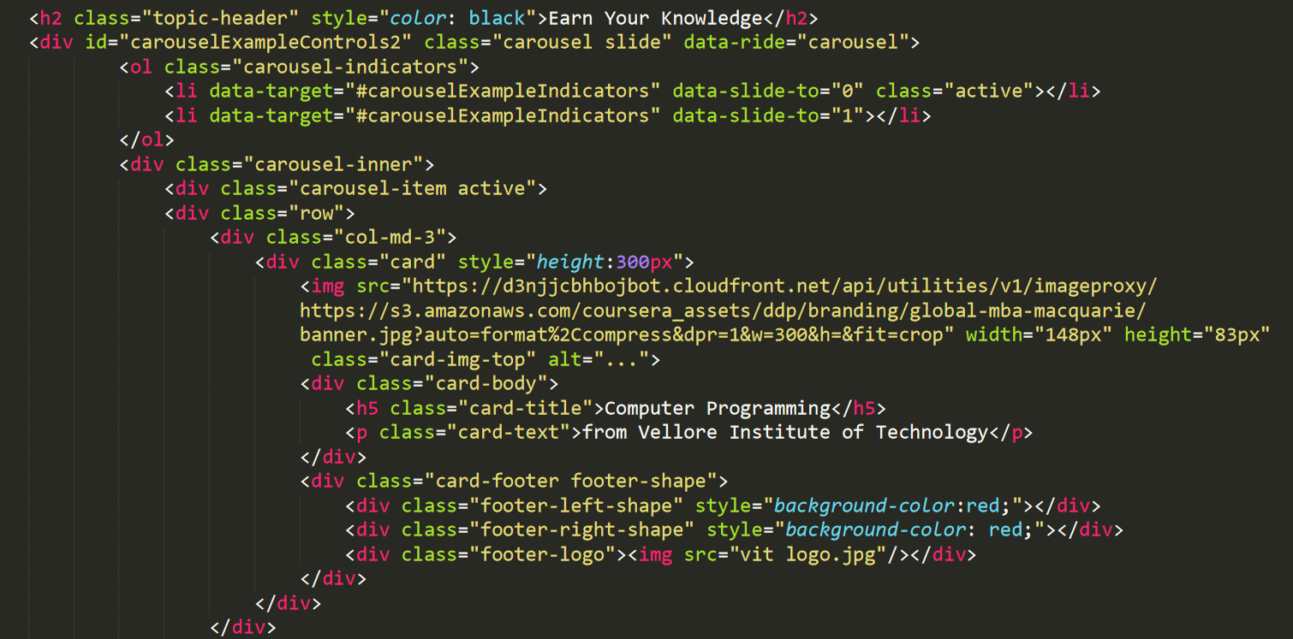
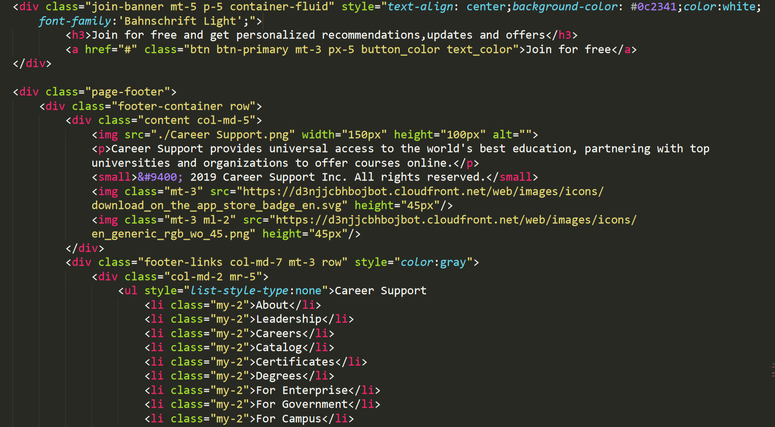

Slide 19
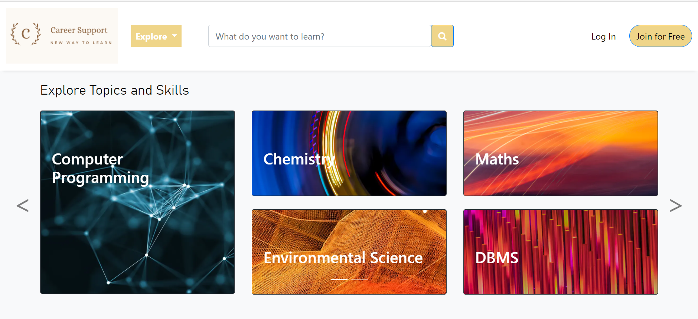
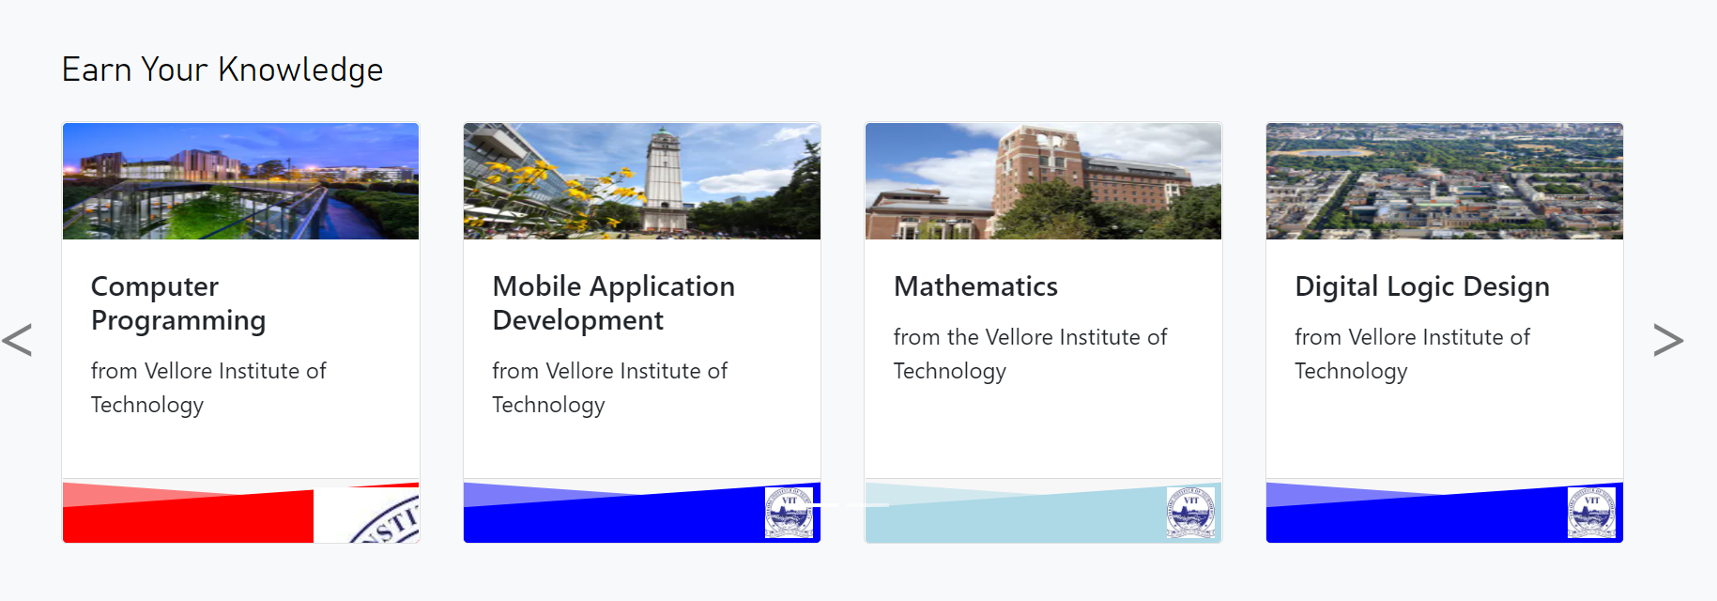
SNAPSHOT OF THE PROJECT

Slide 20
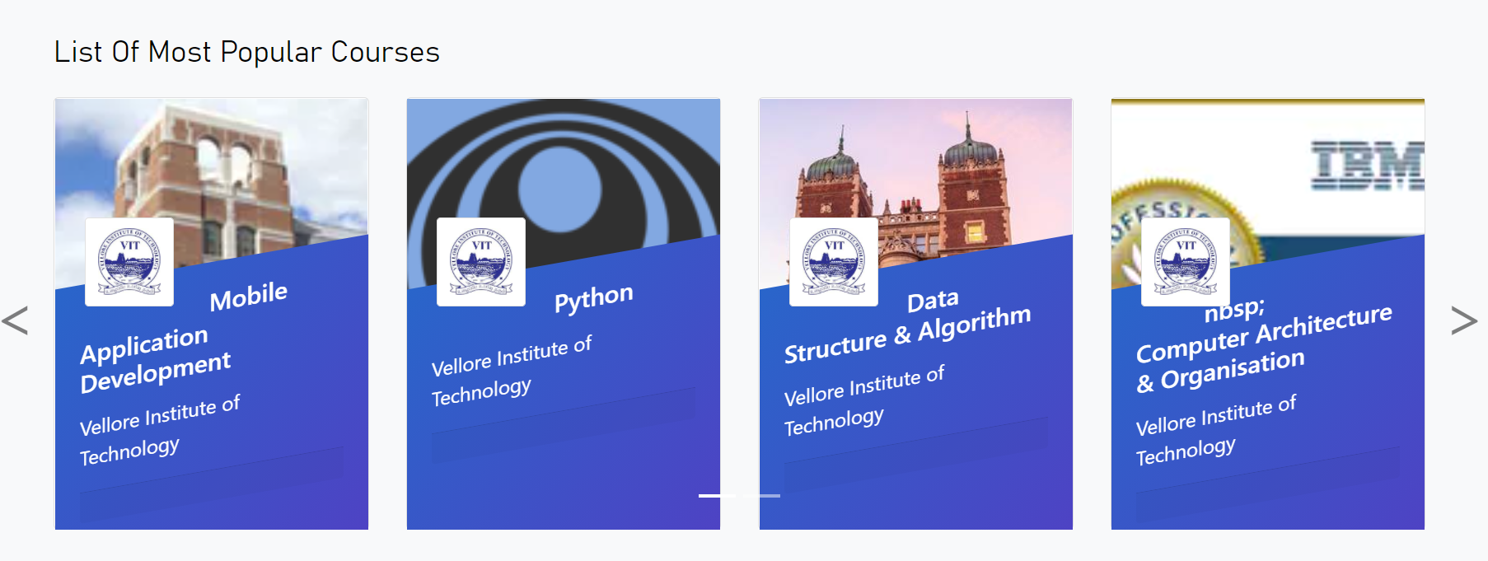
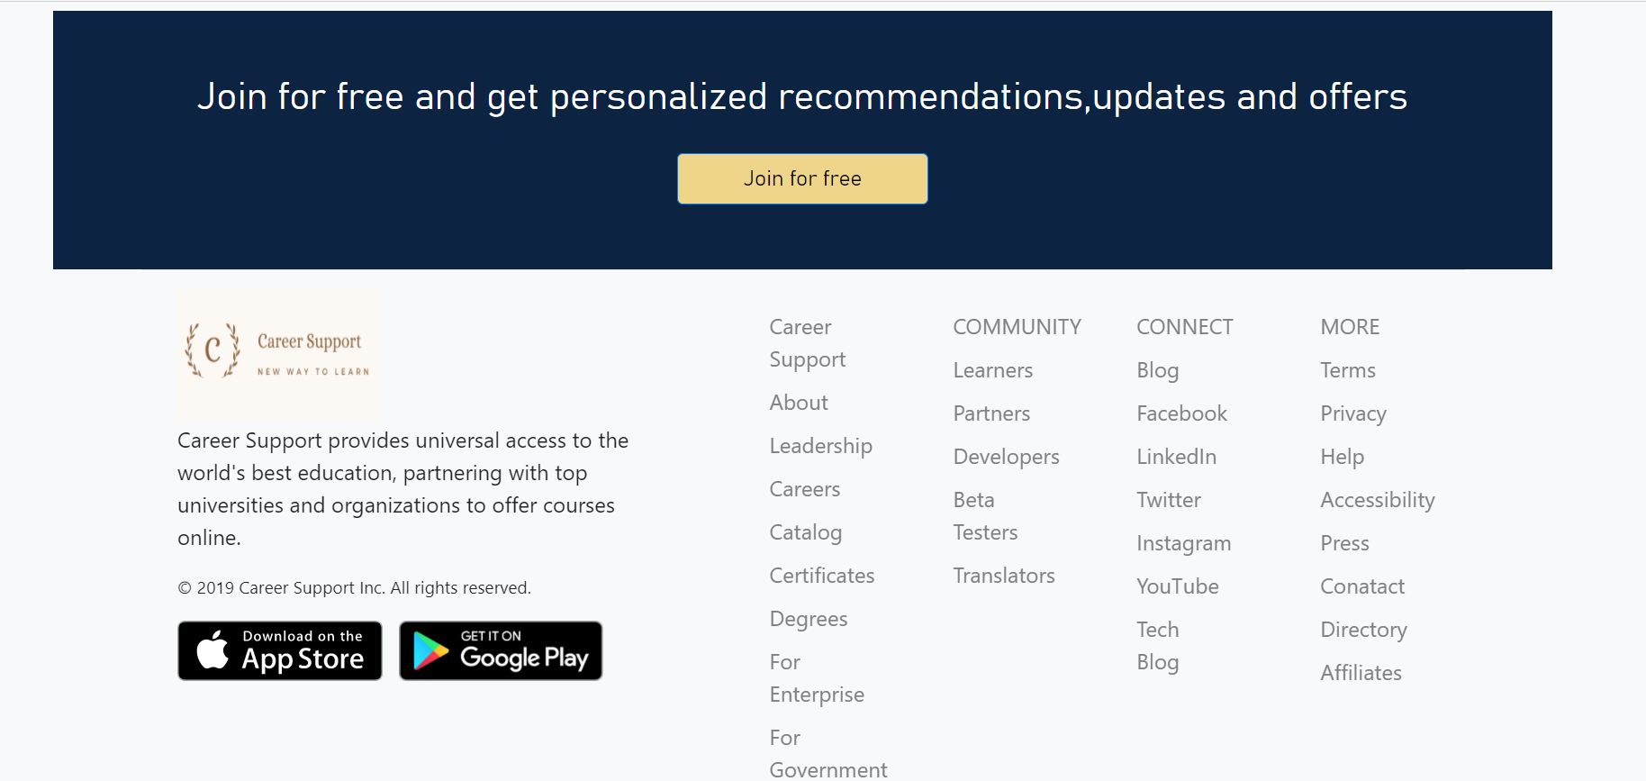

Slide 21
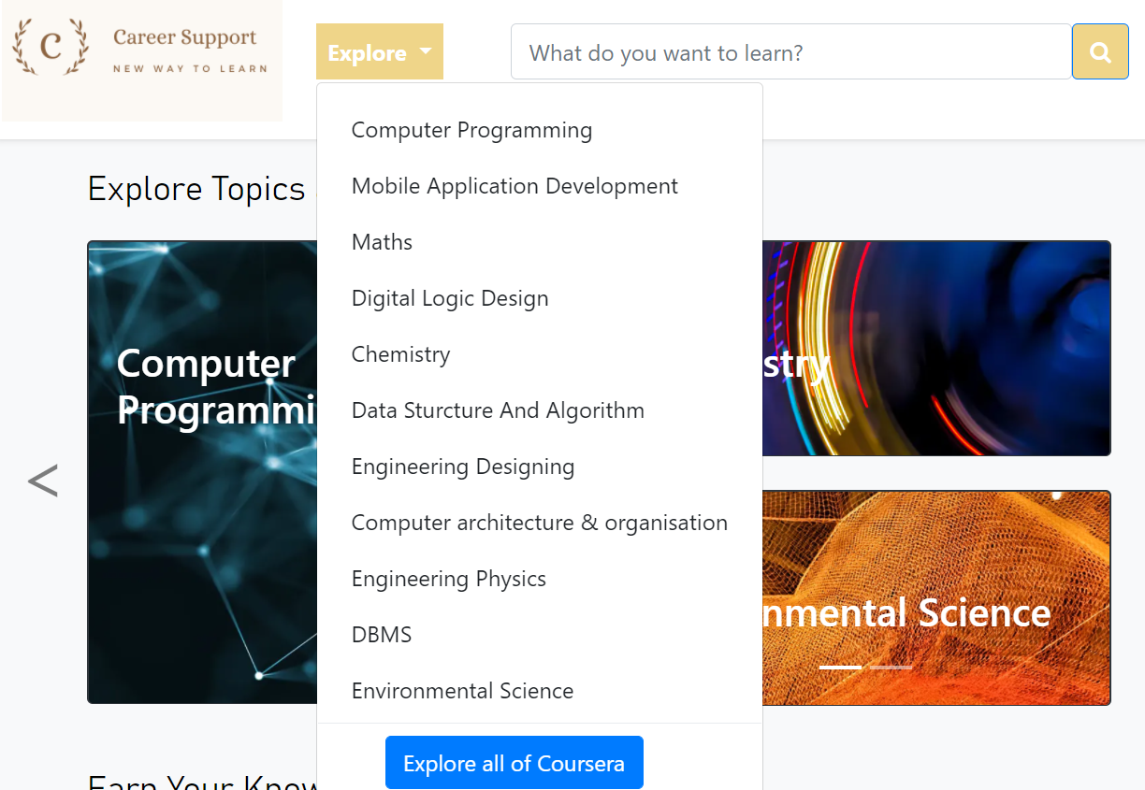
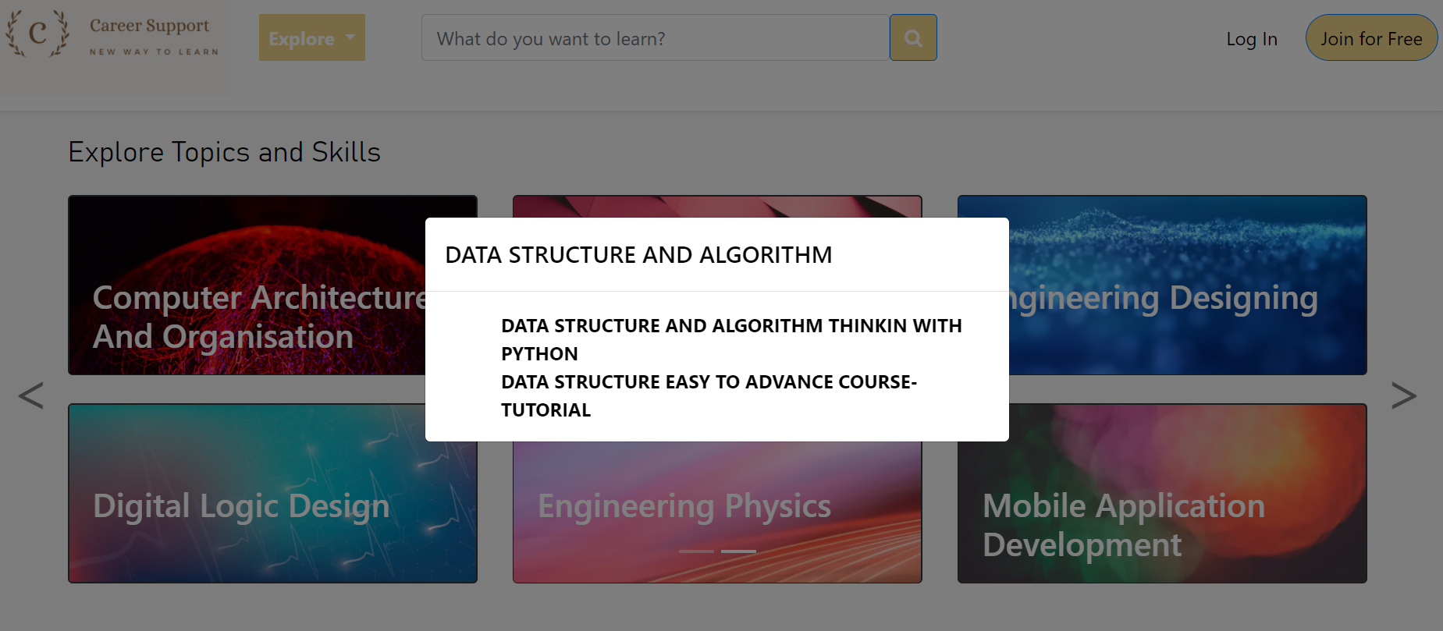
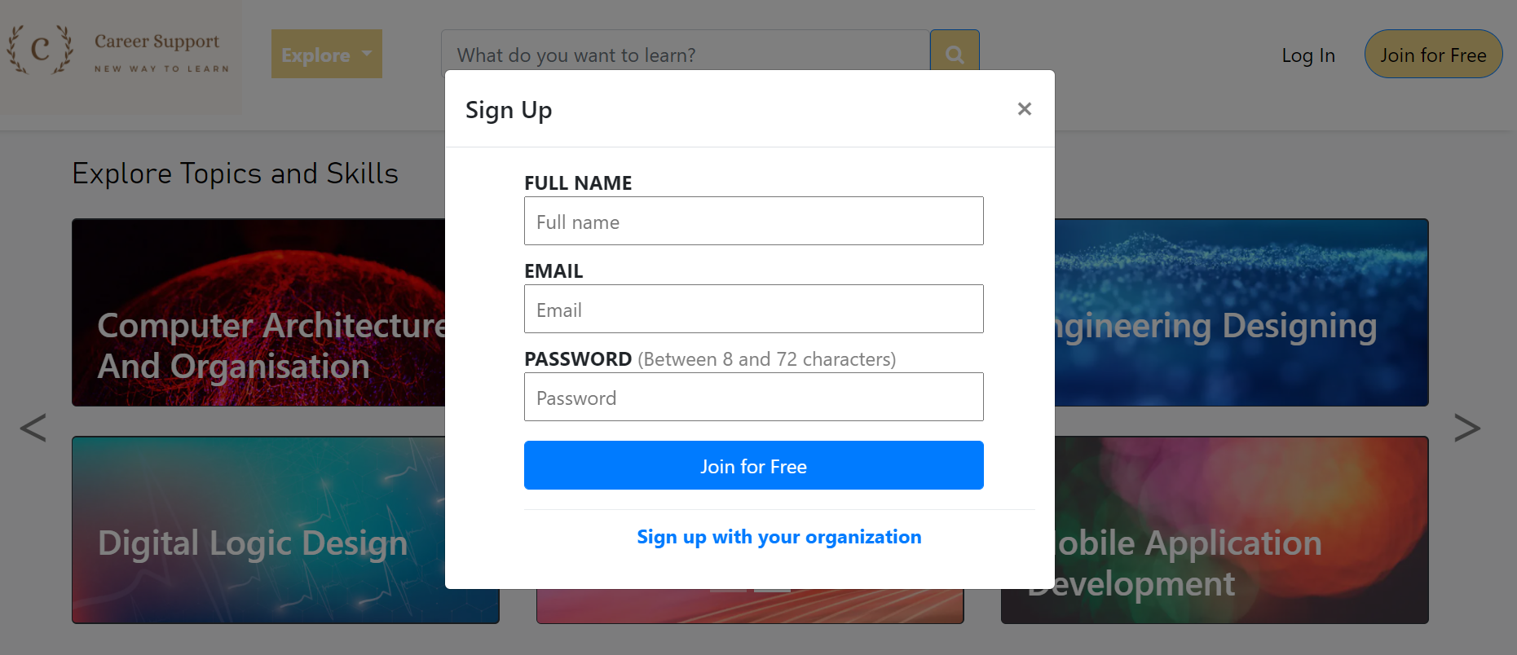
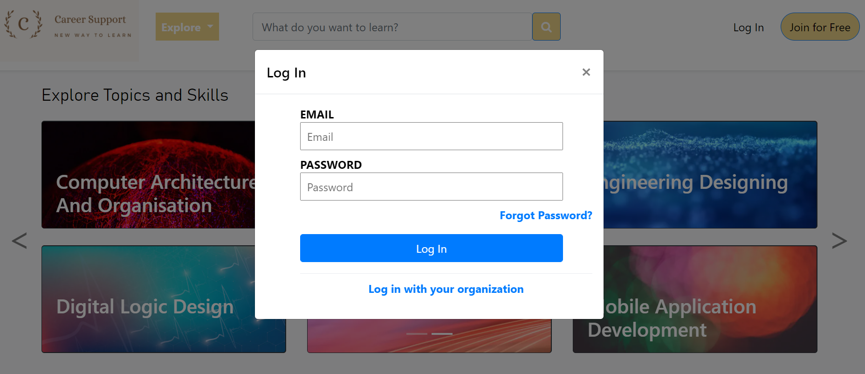

Slide 22
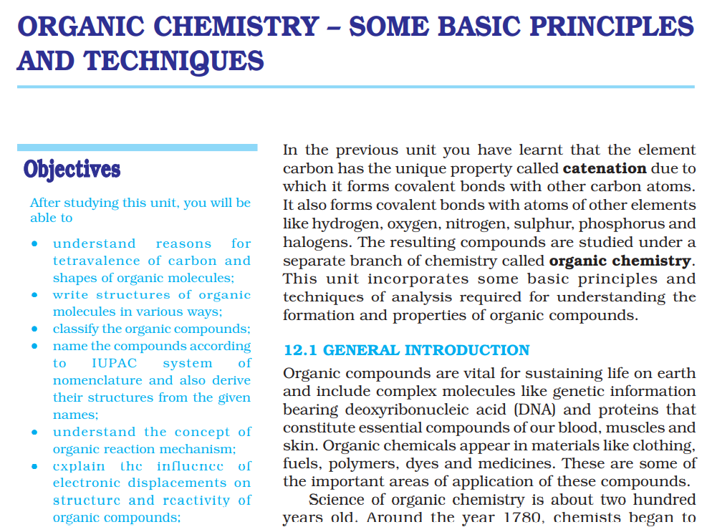
TESTING
The most interesting part is testing.

Slide 23
RESULT & DISCUSSION
Online learning increases access to education for many different types of people. If developed properly, online classes may increase efficiency and course productivity. Hot debate surrounds the social implications of online learning and helps to increase in social interaction too. This presentation could help you find solutions to particular problems arising in your classroom or school.

Slide 24
CONCLUSION
This presentation critically reviewed the literature related to e-learning systems and identified some of the most influential factors used in the field of information systems research. More specifically, this presentation had an insight on the origins, characteristics as well as the limitations, weaknesses and strengths of web-based learning systems. Student variables, such as behaviors and attitudes, cultural backgrounds and other demographic characteristics are important variables that influence student learning, especially in a collaborative e-learning environment. Understanding these variables is now helpful for instructors to design meaningful educational activities to promote student knowledge construction and make learning more effective and appealing. In particular, this research helps to better understand the characteristics of students, which can help policy makers, educators and experts to understand what the students expect from the learning management systems. This can help the management achieve the most effective deployment of such system and also helps them improve their strategic decision making about technology in the future, they can decide on the best approach that fit their students before implementing any new technology.

Slide 25

THANK YOU

